Slide 1
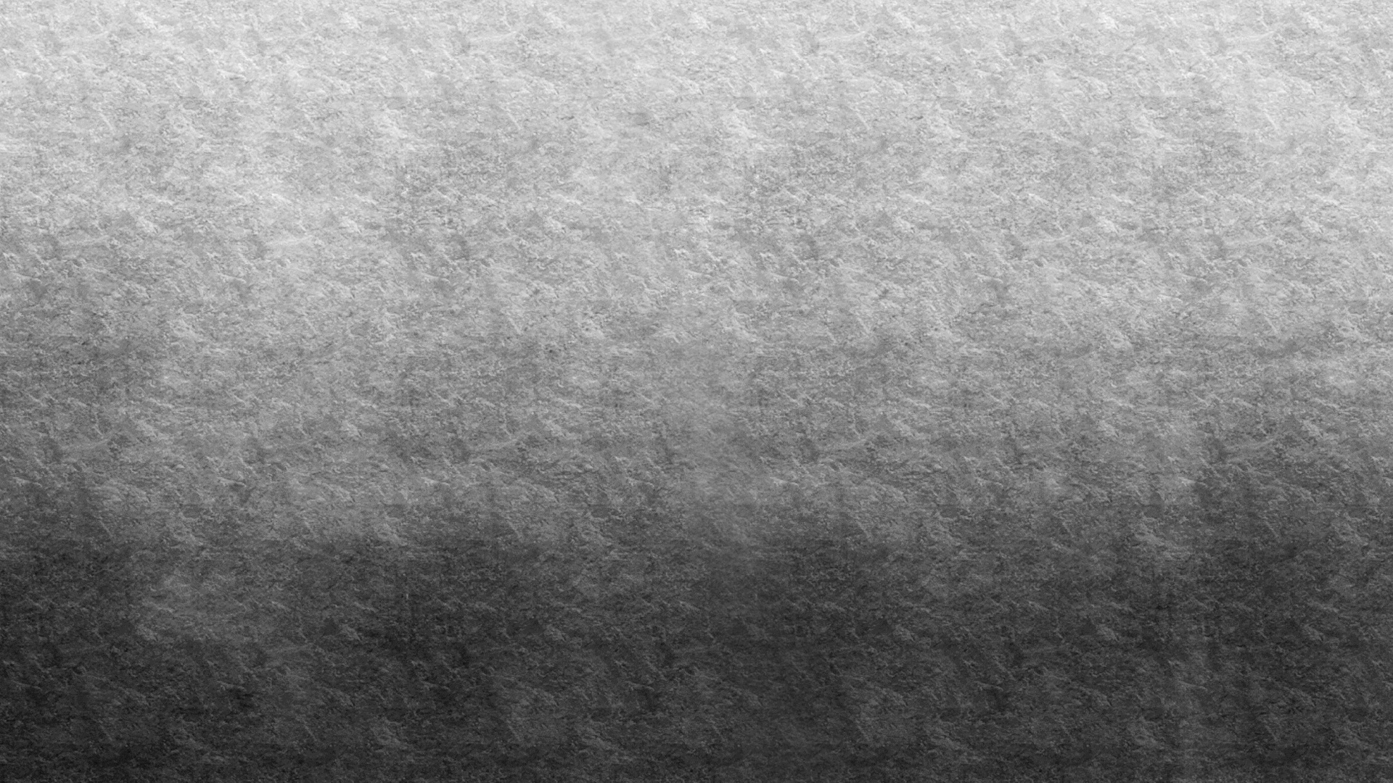

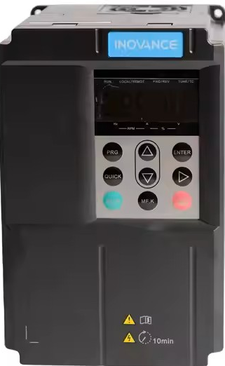
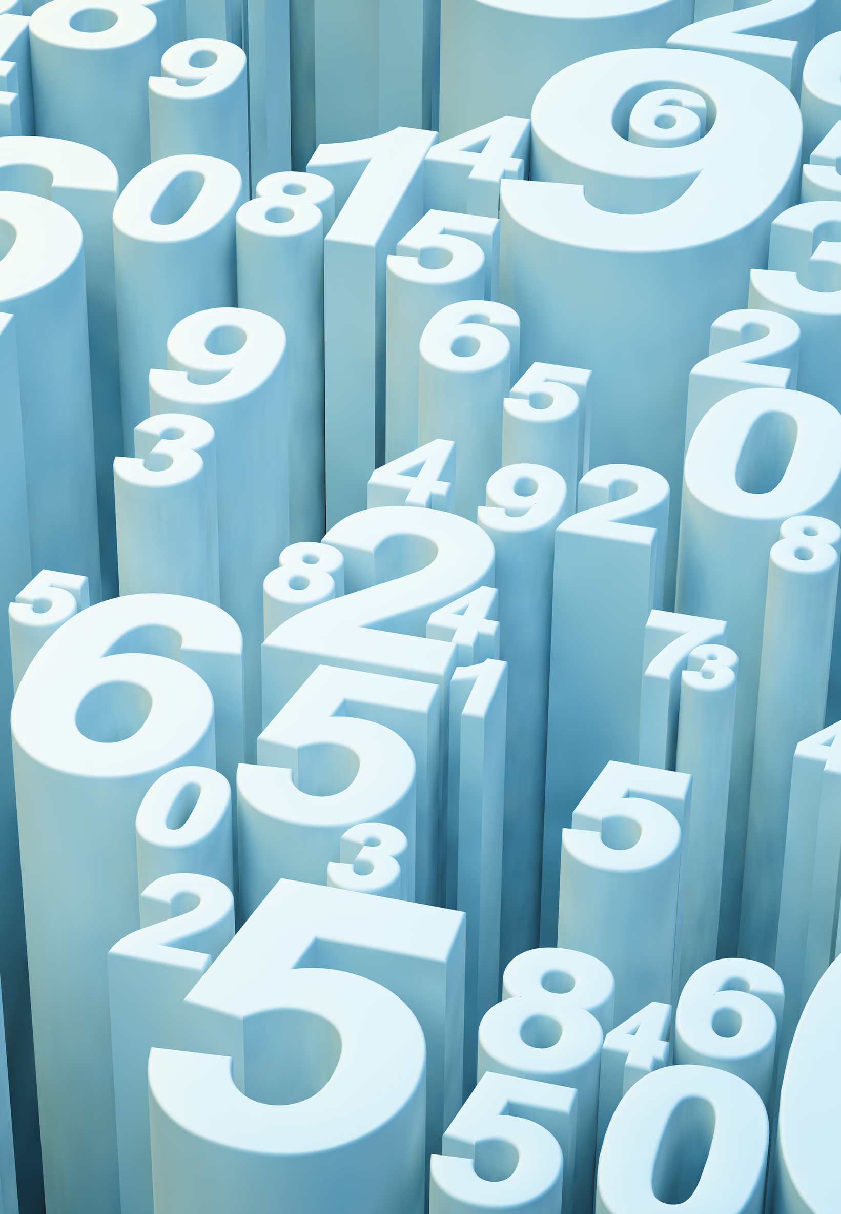
Use of VFD in Renewable Energy Systems
Mohamad rizvan

Slide 2
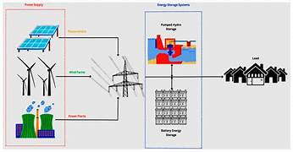
Use of Variable Frequency Drive (VFD) in Renewable Energy Systems
This presentation discusses the role of Variable Frequency Drives (VFDs) in renewable energy systems. It highlights how VFDs improve efficiency, control, and reliability in systems like wind and solar power generation. The presentation also covers applications, advantages, and future scope of VFD technology in sustainable energy solutions.

Slide 3
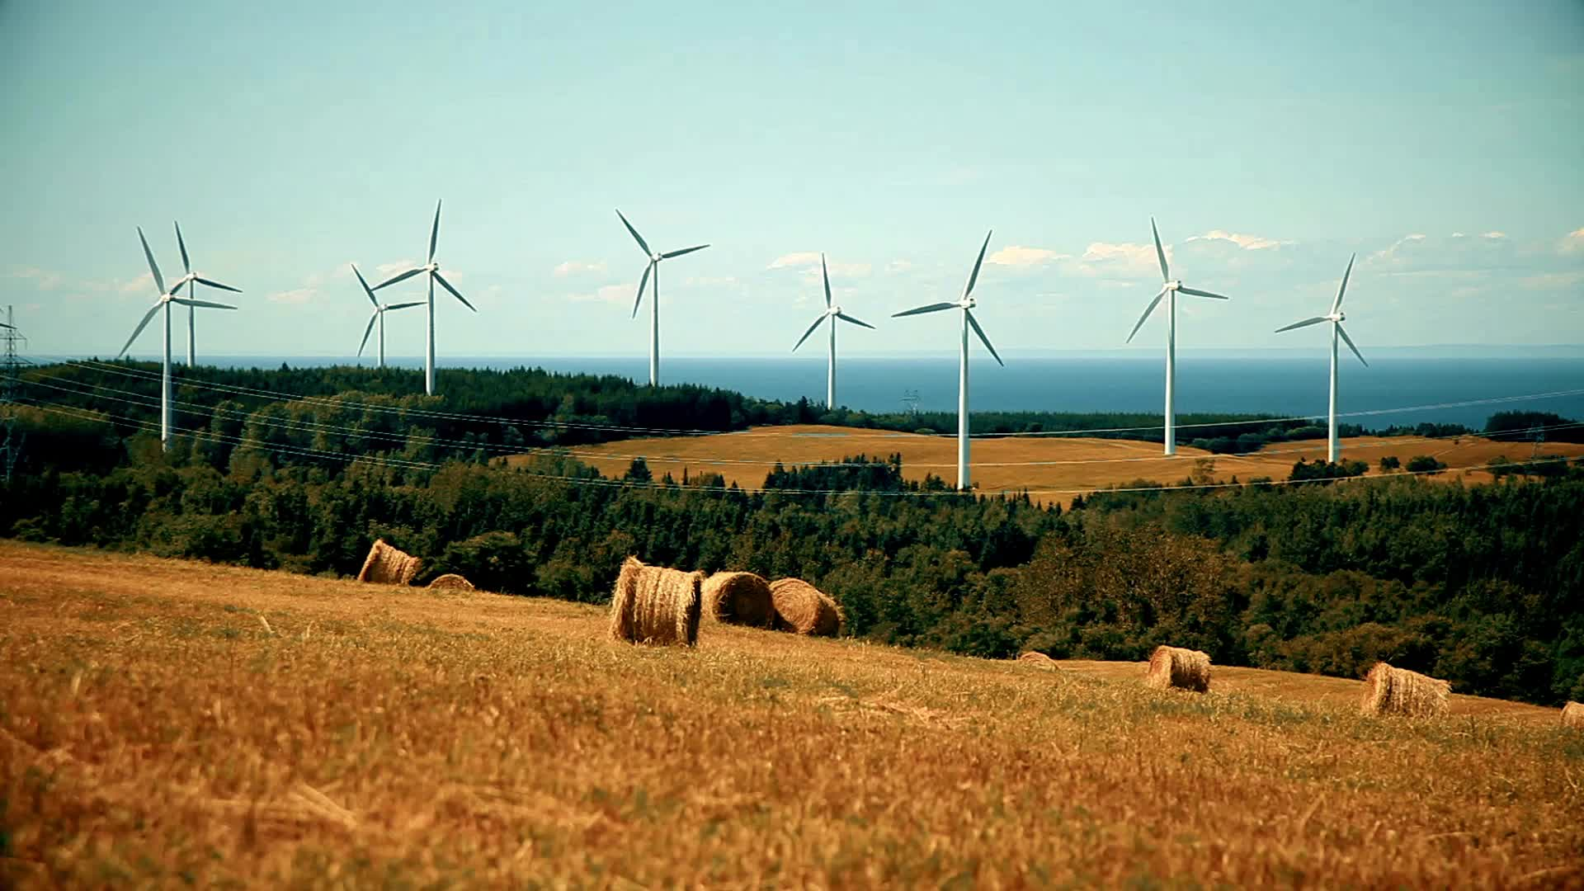
Need for VFD in Renewable Energy
Renewable energy sources are inherently variable and unpredictable. For example, wind speed changes continuously, affecting turbine speed, and solar irradiance varies throughout the day. VFDs help in adapting to these changes by maintaining optimal motor and generator performance, thereby increasing efficiency and reducing energy losses.

Slide 4
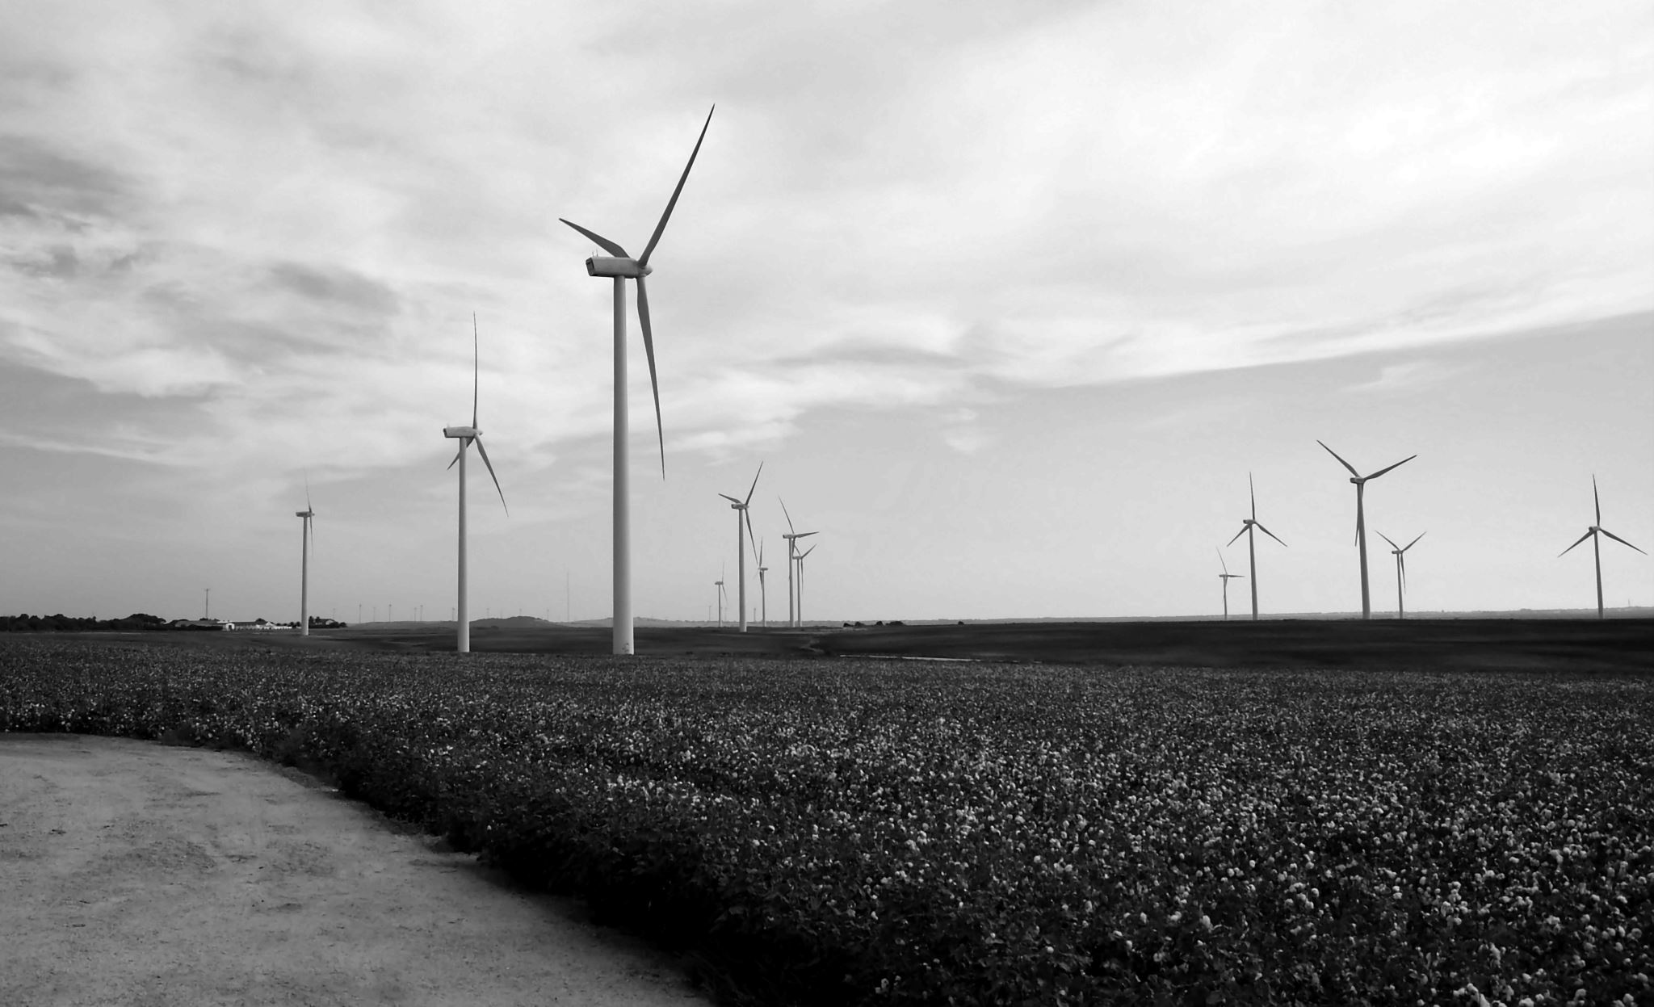
Application in Wind Energy Systems
In wind energy systems, VFDs are used to control the speed of wind turbine generators. Since wind speed is not constant, VFDs allow turbines to operate at variable speeds, maximizing energy capture. This improves efficiency and reduces mechanical stress on turbine components, leading to longer system life.

